Slide 1
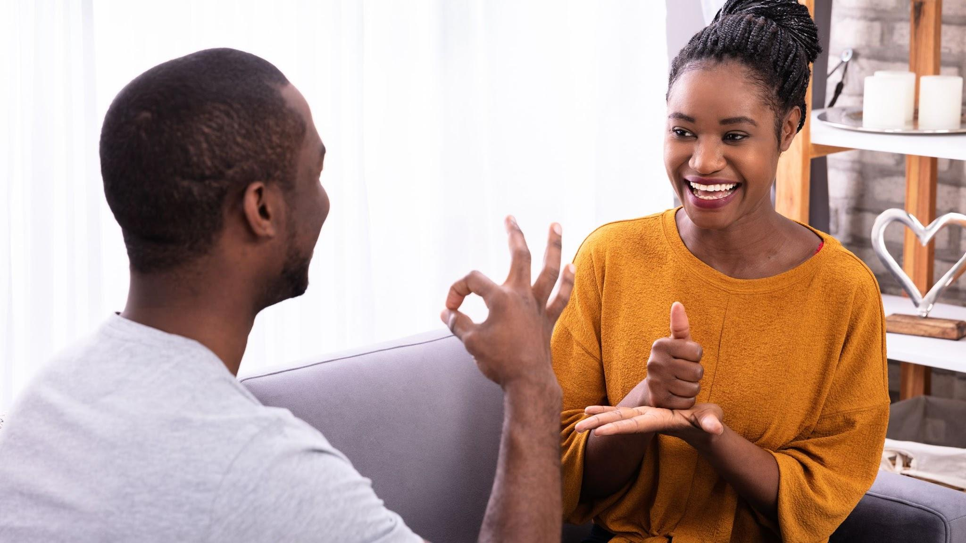
American Sign Language Alphabet Image Classification
Team 5 | Final Predictive Modelling Report
Beard, Bennion, Carlson, Napolitano
August 2022

Slide 2
Recap
1 | Compile an Accurate ASL Alphabet Data Set | Complete
1.1 | Record Raw Video Footage of ASL Alphabet Signs | Complete
2 | Preprocess Data Set To Prepare for Modelling | Complete
2.1 | Split Video Into Still Frames | Complete
2.2 | Normalize Color | Complete
2.3 | Normalize Size | Complete
2.4 | Normalize Resolution | Complete
2.5 | Produce Image Vector CSVs | Complete
3 | Exploratory Data Analysis | Complete
3.1 | Image Class Balance Analysis | Complete
3.2 | Analysis of the Basic Metrics of Variables | Complete
3.3 | Non-Graphical and Graphical Univariate Analysis | Complete
3.4 | Feature Engineering and Analysis | Complete
4 | Develop an ML model capable of learning ASL alphabet | Complete
4.1 | Model I: KNN | Complete
4.2 | Model II: CNN | Complete
4.3 | Model III: CNN with Transfer Learning | Complete

Slide 3
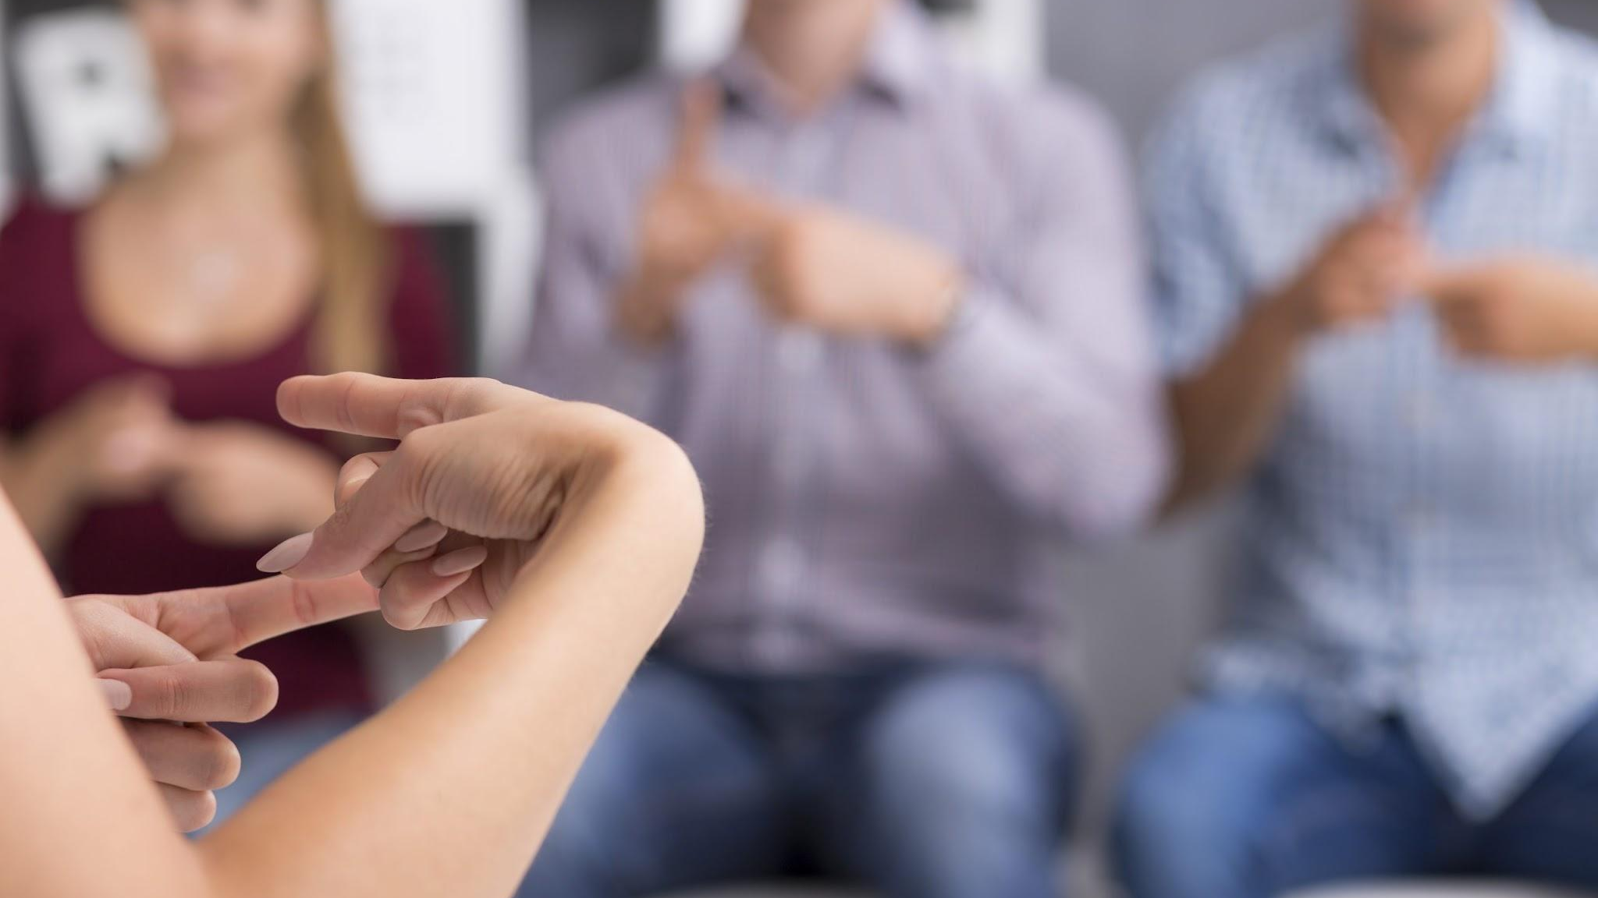
Dataset & EDA Summary

Slide 4
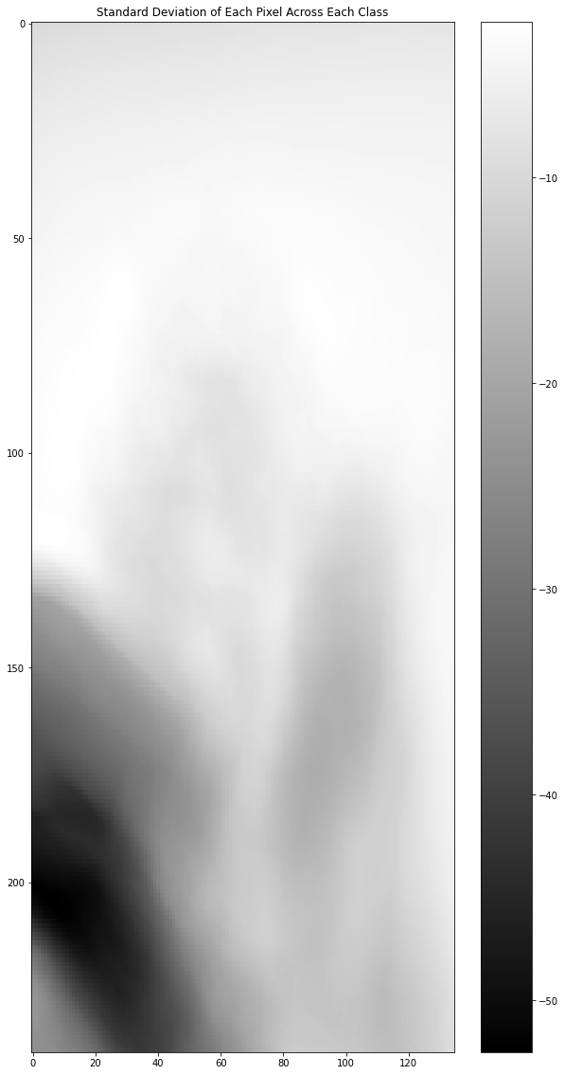
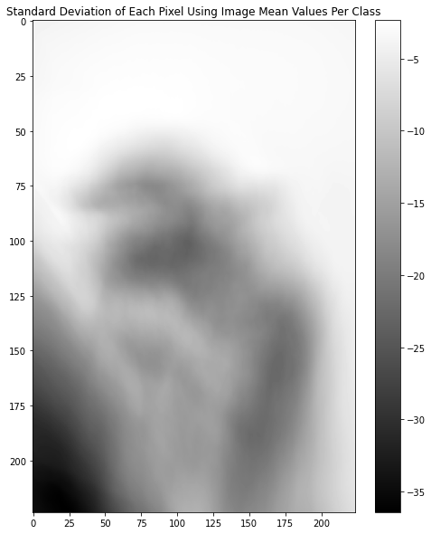
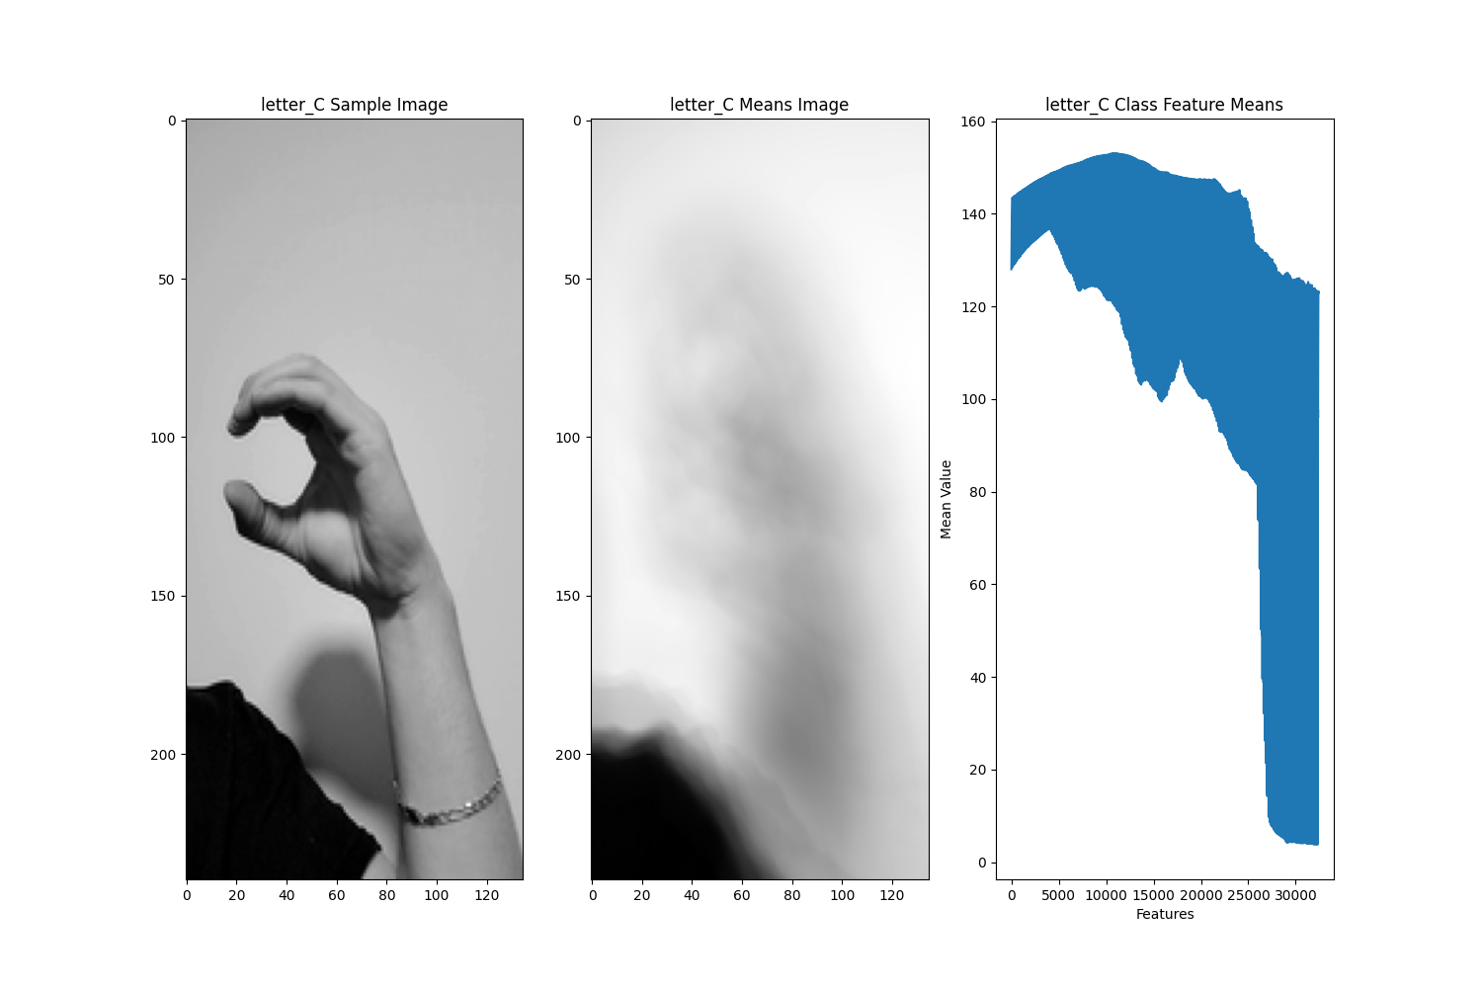
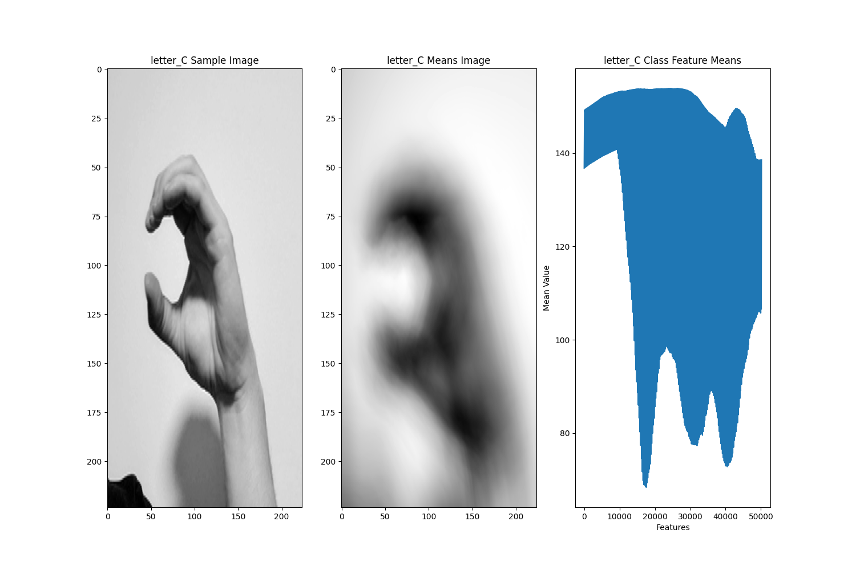
Reintroducing the Dataset
Before
After
24 classes with ~930 images per class.
Excluding J and Z, as these letters require motion.
Cropped images to 224x224 to improve computation time.

Slide 5
Model I - KNN

Slide 6
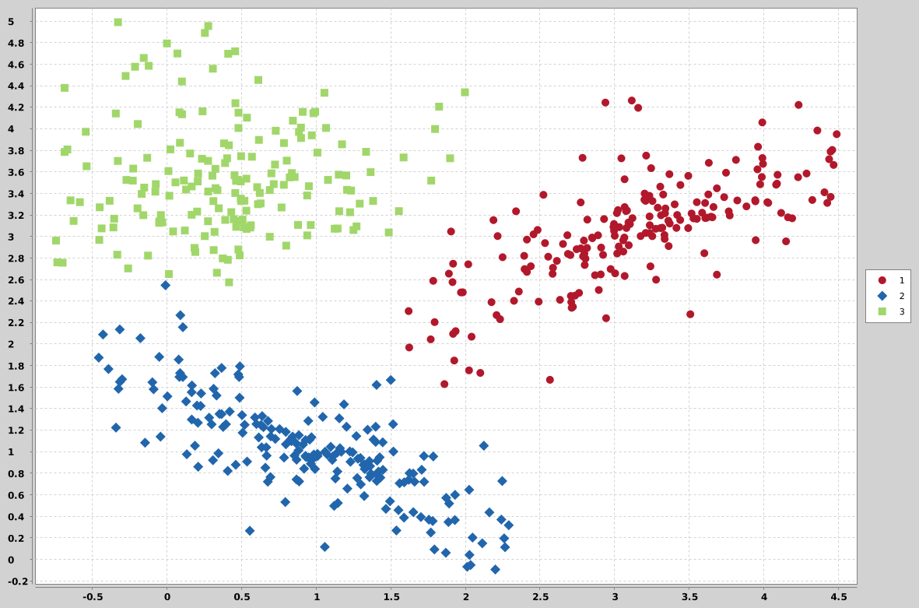
Model I - K Nearest Neighbors
Relies on the assumption that data points that are similar with each other will cluster with each other
Algorithm calculated uses a distance function to estimate the distance between a given point and its neighbors
Algorithm determines a label by evaluating the k neighbors and applying the most common label of that sample
For example, if k = 10, the algorithm will look at the ten nearest neighbors and apply the most common label of those 10 neighbors

Slide 7
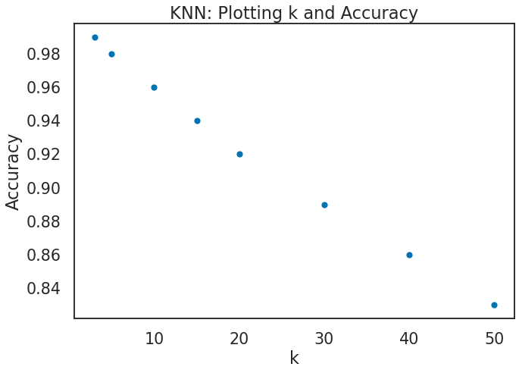
Model I - K Nearest Neighbors
Accuracy is the primary model performance metric*
*Precision and recall can be helpful at the class level but becomes complex to produce at the model-level when evaluating 24 classes
Diminishing returns were observed as we increased the k value from 3 up to 50
k=3 produced an accuracy score of 99% on the test population while k=50 produced just 85% accuracy
Highest Accuracy Achieved: 99.00%

Slide 8
Model II - CNN

Slide 9
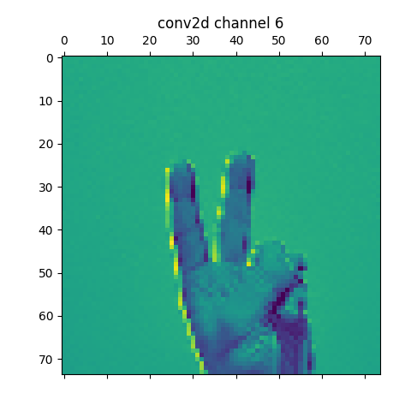
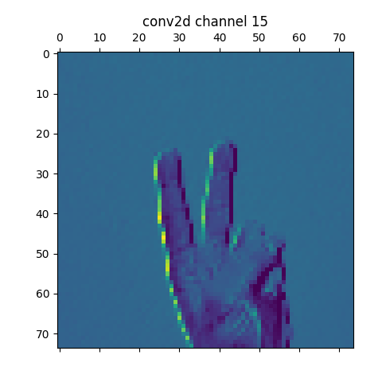
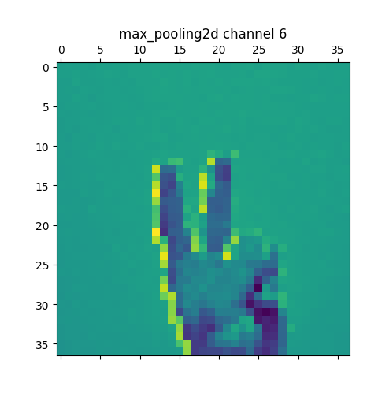
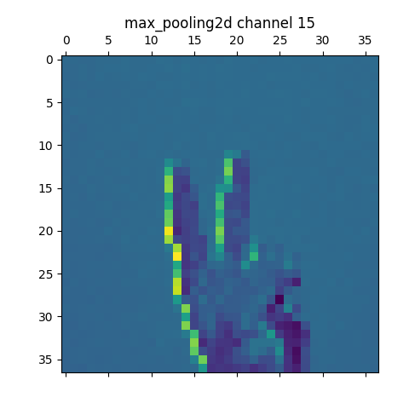
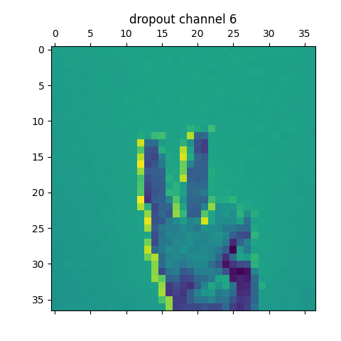

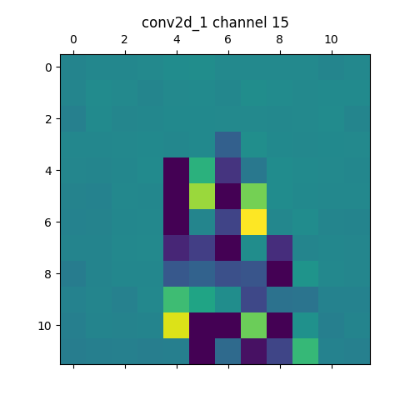
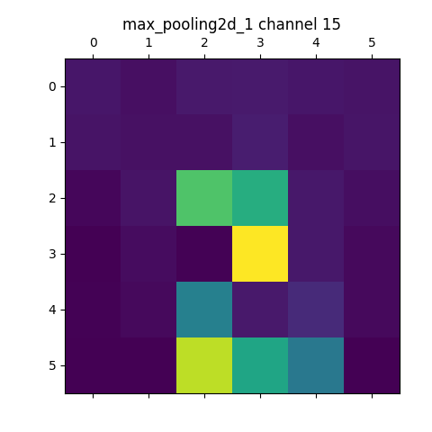
Model II - CNN Intro
Concept inspired by biology and how human brains process visual information. Visual cortexes contain neurons that trigger only in response to specific shapes (such as edges, or horizontal lines).
CNNs use kernels and convolutions to identify patterns.
The kernel itself can be thought of like a window as it slides across the input image in search of patterns
Convolutions are mathematical mathematical functions/techniques that are performed on the image to help the kernel identify patterns (e.g edge detection, embossing, blurring, sharpening, etc)
The product is an array that comes as a result of multiplying the kernel and image together called the “feature map.”
The feature map is essentially a “map” that points to where that particular pattern (or feature) is located in the original image. Feature maps become more and more complex in later layers of the neural network. Initial layers can identify things such as diagonal lines, intermediate layers can identify things such as eyes, and advanced layers identify things like faces and buildings.
Less Convolutions
More Convolutions
Notes:
For our 2nd model we decided to use a convolutional neural net. This algorithm is based of the deep learning structure of an artificial neural network but with some definitive differences. Instead of simply passing the inputs through the network and adjusting their weights and biases at each layer, the cnn examines a filtered group of inputs, that represent a smaller grid of the larger image. These are called kernels and are one of our hyper parameters. Every part of the image has this kernel applied to it and from here the convolutional layer identifies distinct attributes. After each layer, typically, a max pooling layer is applied. This means that for each kernel that was done and calculated as a results of the convolution, you then take the max value from all of those values. This helps the network learn what's most important while filtering out the unnecessary noise or edge values. As you can see at the bottom of the slide, each layer is identifying the features of the image with different channels. The max pooling layer then aggregates all those features and takes the max from each kernel. This is why you get a blurrier image as you progress through each layer. This is how the CNN recognizes the important features of each class.

Slide 10
Model II - CNN Justification
Our dataset has one main limitation - size.
CNNs leverage a few key ideas to deliver best-in-class accuracy while driving computational efficiency
Sparse Interaction - the ability of CNNs to extract meaningful information from a large input feature pool and store a much smaller collection of parameters.
In our case, the model will read in about 930 samples of 50,176-integer vectors for each of our 24 classes and simplify into a much smaller set of key parameters during the convolutional layer.
Shared Parameters - Instead of assigning and then discarding each element in the weight matrix, a CNN uses the same weights across several inputs.
Reduces the memory load during operation.
Equivariance to Translation - Model output changes in a consistent manner relative to changes in the inputs to the model
These ideas combine to enable an algorithm known for delivering accuracy to the field of image classification. This method has been used previously to achieve 98% accuracy on classifying an ASL alphabet dataset using a 7 layer CNN.
Notes:
We chose to use a CNN as our 2nd model because there is no better alternative when trying to classify images. The thing that makes CNN’s so good for classifying and doing image work is that its able to extract meaningful attributes from a large feature pool which are the pixels in an image. A 224x224 image has 50176 features that the CNN has to process. A CNN takes all those features and simplifies them into a smaller set of key features for the next layer. Additionally, the weight matrix is saved and used across several of the input features. When the inputs change for each image, there is a consistent relative change to the outputs. In previous projects that have used CNN’s to classify the ASL alphabet they achieved a 98% accuracy rate using a 7 layer CNNN.

Slide 11
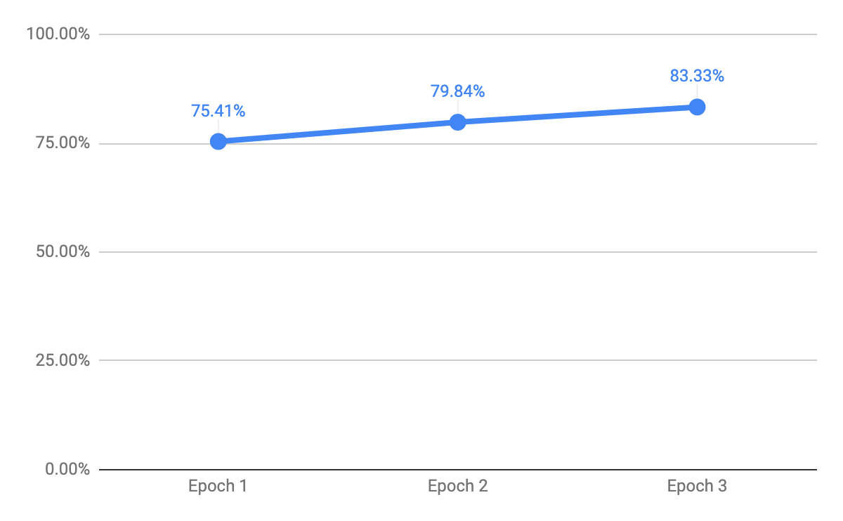
Model II - CNN Initial Attempts
Early epochs took about 10 minutes each
Epoch 1: 75.41%
Epoch 2: 79.84%
Epoch 3: 83.33%
Notes:
Initial attempts were not great as each epoch took a long time to process and started out with low accuracy scores. Strides, which are how much the kernel moves across the image, are initially set to 1x1. This ended up taking 10 minutes for each epoch when the kernels were 3x3. As we began to play around with our hyperparameters we were able to achieve a much faster epoch time, as well as much better accuracy scores.

Slide 12
Model II - CNN Areas for Improvement & Adjustments
Slow epoch iteration times reduced 90% (~10 minutes to ~1 min per iteration) while increasing accuracy to 96%
Changed the stride to 3x3 from 1x1 and changed the kernel size to use 5 in the first layer and then 3 in the following layers.
Computing power limitations
Granted access to Drexel Computing resources that provide more CPU power than any individual machine or parallel processing resources we were accessing
Explored improvements to Accuracy. Additional attempt dropped accuracy to 93% and confirmed initial architecture.
Attempted different architectural styles by adding another convolutional layer, set the dropout to .3, and moved the second maxpool to execute last.
Final model accuracy: 98.70%
Notes:
The first thing we did to improve the time it took for each epoch was to increase the stride from 1x1 to 3x3.. This massively reduced the time it took to train our model and therefore, we were able to play around with our hyperparameters a lot more. Additionally, we were able to run more epochs and this helped getting us to accuracy score of 96%. We ended up settling on a simple 2 layer CNN with max pooling and a dropout layer after each of .2 to help reduce overfitting. For the first layer we set the kernel size to 5 in order to incorporate more features at the start of the mode. We then reduced that to 3x3 to try and let the model examine smaller features. We ended up with an accuracy of 98.7. We did have some limitations. Computing power was an issue when scaling up the number of layers as well as running many more epochs. We enlisted the help of Drexel computing to user their cpus. We also experimented with using more layers and playing around with the architecture of when to put in dropout and max pool layers but this ended up achieving a lower accuracy. In conclusion, we were happy with our final accuracy and learned a great deal about CNN’s and how they work.

Slide 13
Model III - TL-CNN

Slide 14
Model III - Transfer Learning CNN Intro
Uses the same principles of CNNs, however, transfer Learning CNNs allow you to apply the parameters of a pre-trained model to another dataset.
Allows one to take a model that was trained on a large dataset and use it on a small dataset, potentially one with less-than-ideal number of images.
Especially enticing for those who do not have access to large datasets, don’t have sufficient hardware to process or store these datasets, or don’t have the funds to use a cloud-based tool to store/process these datasets and models quickly.
However, there is a major assumption that whatever model you are using was trained on a dataset similar to your own.
This will allow us to focus on the very last fully connected layers to try and achieve optimum accuracy

Slide 15
Model III - Transfer Learning CNN Justification
Provide many of the same benefits of a standard CNN trained from scratch while enabling the researcher to leverage weights that have been pre-trained on similar datasets.
In our case, we have identified CNN weights that have been trained based on a 16-layer deep pre-trained CNN that achieved 97% accuracy for an ASL alphabet dataset developed by a group of Oxford researchers. Using the weights associated with a CNN of such strong performance can increase the efficiency of our research if implemented correctly.
Talent borrows; genius steals.
The business world calls this leveraging.

Slide 16
Model III - Transfer Learning CNN - Technical Specifications
Model Architecture:
VGG16 (all layers non-trainable)
VGG16(input_shape=[224,224,3], weights='imagenet', include_top=False)
VGG16 layers all set to non-trainable
Prediction layer
Dense(24, softmax)(vgg16 flattened output)
Model additional hyper-parameters:
Epochs: 4
Batch size: 32
Loss: categorical cross-entropy
Optimizer: ADAM
Metrics: accuracy

Slide 17
Model III - Transfer Learning CNN
Initial test
Mini-batch of data (1%)
Data split: 70% train, 20% validation, 10% test
10 epoch limit
Reached max accuracy (88%) at 4 epochs
Main test
Full dataset
Data split: 70% train, 20% validation, 10% test
4 epoch limit
See next slide for performance

Slide 18
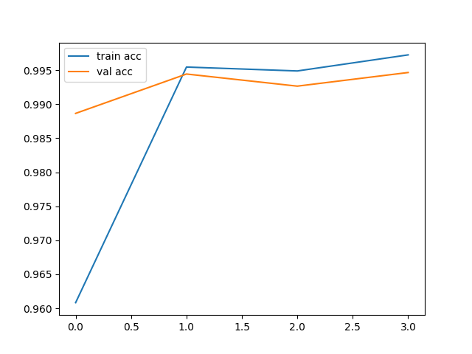
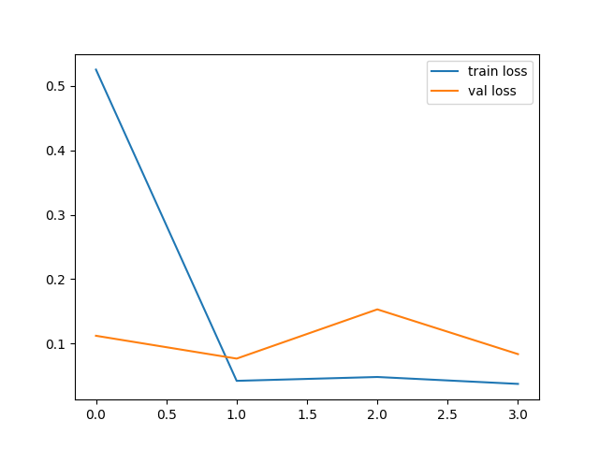
Model III - Transfer Learning CNN Results
Approximately 2.5 hours to run 4 epochs (~40 mins per epoch) to produce accuracy of 99.59%
Accuracy
Loss

Slide 19
Model III - Transfer Learning CNN Areas for Improvement & Adjustments
A slight overfit
Explore different hyperparameters (e.g. trainable transfer layers, optimizer, etc.)
Acquisition: more variety and quantity.
Challenge the algorithm
Higher sample count to feature count ratio should also lower overfitting. (https://brb.nci.nih.gov/techreport/Subramanian-Overfitting.pdf)

Slide 20
Final Results

Slide 21
Final Results & Lessons Learned
Final Model Results
KNN: 99.00% (3 neighbors)
CNN: 98.70% (10 epochs, kernel size layer 1 =5, kernel size layer 2 = 3. Dropout = .2, stride =3x3)
TL-CNN: 99.59% (4 epochs, weights = 'imagenet', include_top = False)
Lessons Learned
Technical: How to implement CNN and transfer learning. Changing the strides to 3x3 drastically reduced the training time without hurting the accuracy.
Practical: Understanding the marginal costs (in time and money) of additional performance. Is an additional 0.05% accuracy worth $y and z hours?
Future: With high-performing results from a clean and uniform dataset with accurate samples, future exploration of larger, but still accurate, datasets is advised.

Slide 22
Thank you

